Slide 1
DIGITAL MEDIA LITERACY : FACT CHECKING & COUNTERING FAKE NEWS
DR. MUHAMMAD MURAD KHAN
ASSISTANT PROFESSOR
COMPUTER SCIENCE DEPARTMENT
HTTPS://www.murad.phd/mc

Slide 2
TABLE OF CONTENTS
PART 1 : IMPORTANCE OF DIGITAL LITERACY
PART 2 : THE SPREAD OF MISINFORMATION VIA SOCIAL & ELECTRONIC MEDIA
PART 3 : TOOLS TO VERIFY NEWS
PART 4 : ETHICAL CONSIDERATIONS IN THE DIGITAL SPACE
PART 5 : GOVERNMENT AND INSTITUTIONAL EFFORTS IN PAKISTAN
PART 6 : CONCLUSION AND CALL TO ACTION

Slide 3
PART 1 : IMPORTANCE OF DIGITAL LITERACY
MEDIA
MAINSTREAM VS DIGITAL MEDIA
SCALE
AUDIENCE COMPARISON
DIGITAL LITERACY IN PAKISTAN

Slide 4
media shapes public discourse by informing, entertaining, and influencing how people understand and interact with the world.

Slide 5
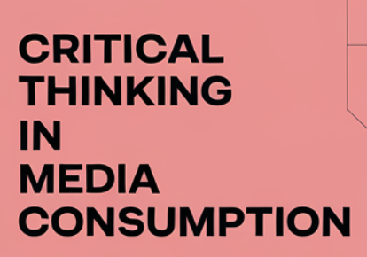
MASS COMMUNICATION

Slide 6
Social and Traditional Media Usage:
A Demographic Analysis of Pakistani Youth

Slide 8
64% Population below 35 years old

Slide 10
IN 2016 AT LEAST 10,000 ROHINGYA REPORTEDLY KILLED
Over 700,000 displaced, with significant destruction of homes, farmland, and infrastructure.

Slide 12
PART 2 The Spread of Misinformation via Social & Electronic Media
Misinformation in the Digital Era
Why Fake News Spreads
Real-World Examples (Pakistan)

Slide 16
PART 3
Tools to Verify News

Slide 17
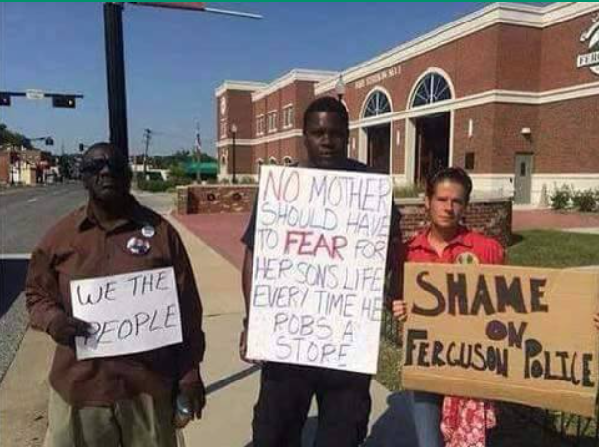
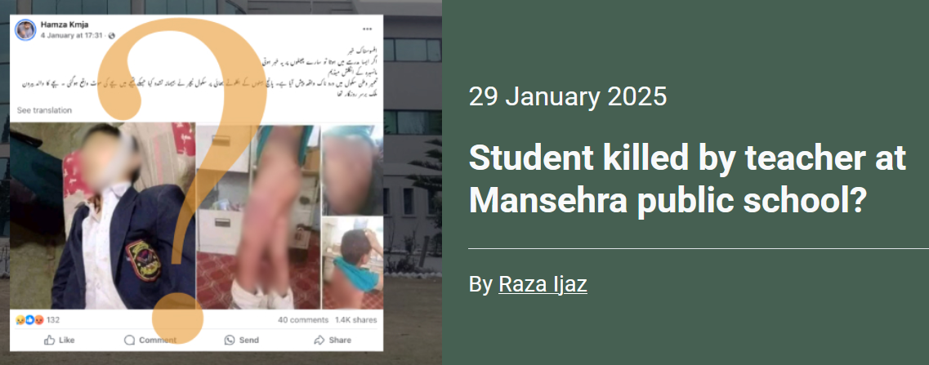
Examples

Slide 18
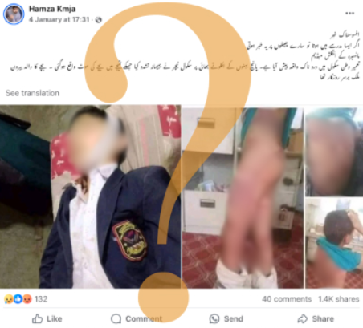
Step 1 : Search
Identify source of information
Source is reliable ?
My list of reliable sources
News websites
Govt Websites
Search the web
Extract keywords : Mansehra Student killed
Search query :
(your search words) site:(web link)
Mansehra Student killed site:dawn.com

Slide 19
Step 2 : Cross verify
Search the web
Extract keywords : Mansehra Student killed
Search query :
(your search words) site:(web link)
Use multiple web links
Dawn.com
Tribune.com.pk
Mansehra Student killed site:dawn.com
Mansehra Student killed site:Tribune.com.pk

Slide 20
Step 3 : Utilize Fact-Checking Websites
https://www.sochfactcheck.com
https://www.sochfactcheck.com/maria-butt-peddles-anti-trans-claims-following-trumps-election-victory/

Slide 21
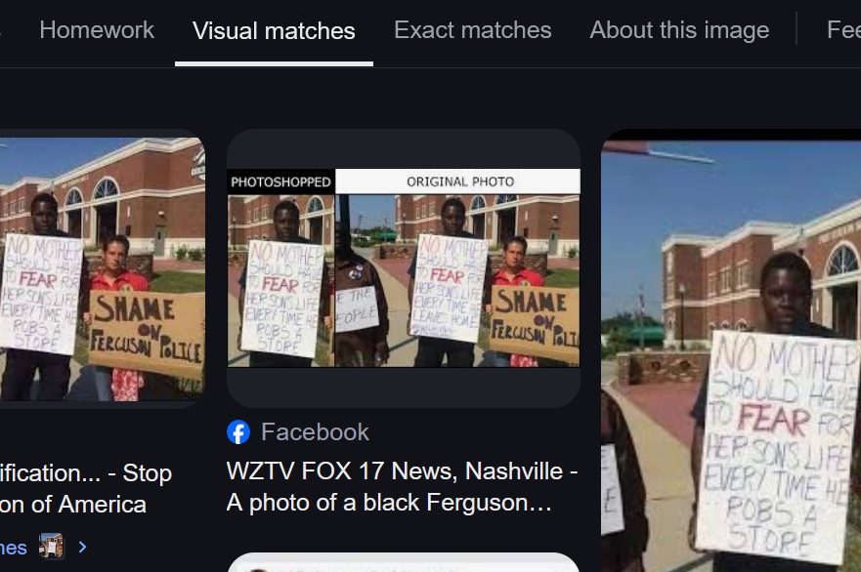
Step 4 : Reverse Image Searches
Search image on google image search
See other images
Identify source

Slide 22
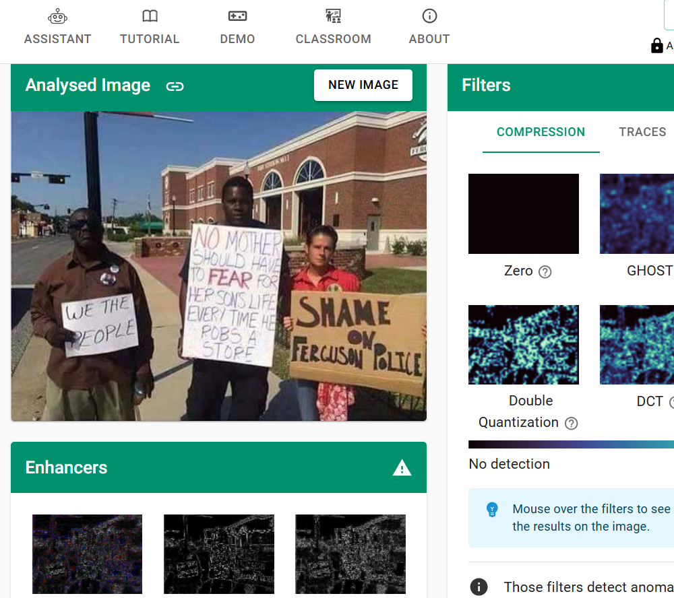
Step 5 : Verify Videos Using Key Frames
https://weverify.eu/verification-plugin/
https://www.youtube.com/watch?v=52ZV8HO0wrA

Slide 23
Step 6 : Leverage Community Notes

Slide 24
Step 7 : Report the news

Slide 25
PRACTICE
https://tinyurl.com/mkp001

Slide 26
PART 4 Ethical Considerations in the Digital Space

Slide 27
Ethical Considerations
Verify Before Sharing:
Always confirm the authenticity of information before sharing
Respect and Civility:
Engage in online discourse with respect and avoid knee-jerk reactions, hate speech, or cyber-bullying—even when faced with provocative content.
Protecting Privacy:
Do not spread personal data or gossip; protecting your own privacy is equally important to prevent scams and manipulation.
Ethical Digital Citizenship:
Recognize that with the power to share information instantly comes the responsibility to use it wisely and ethically.

Slide 28
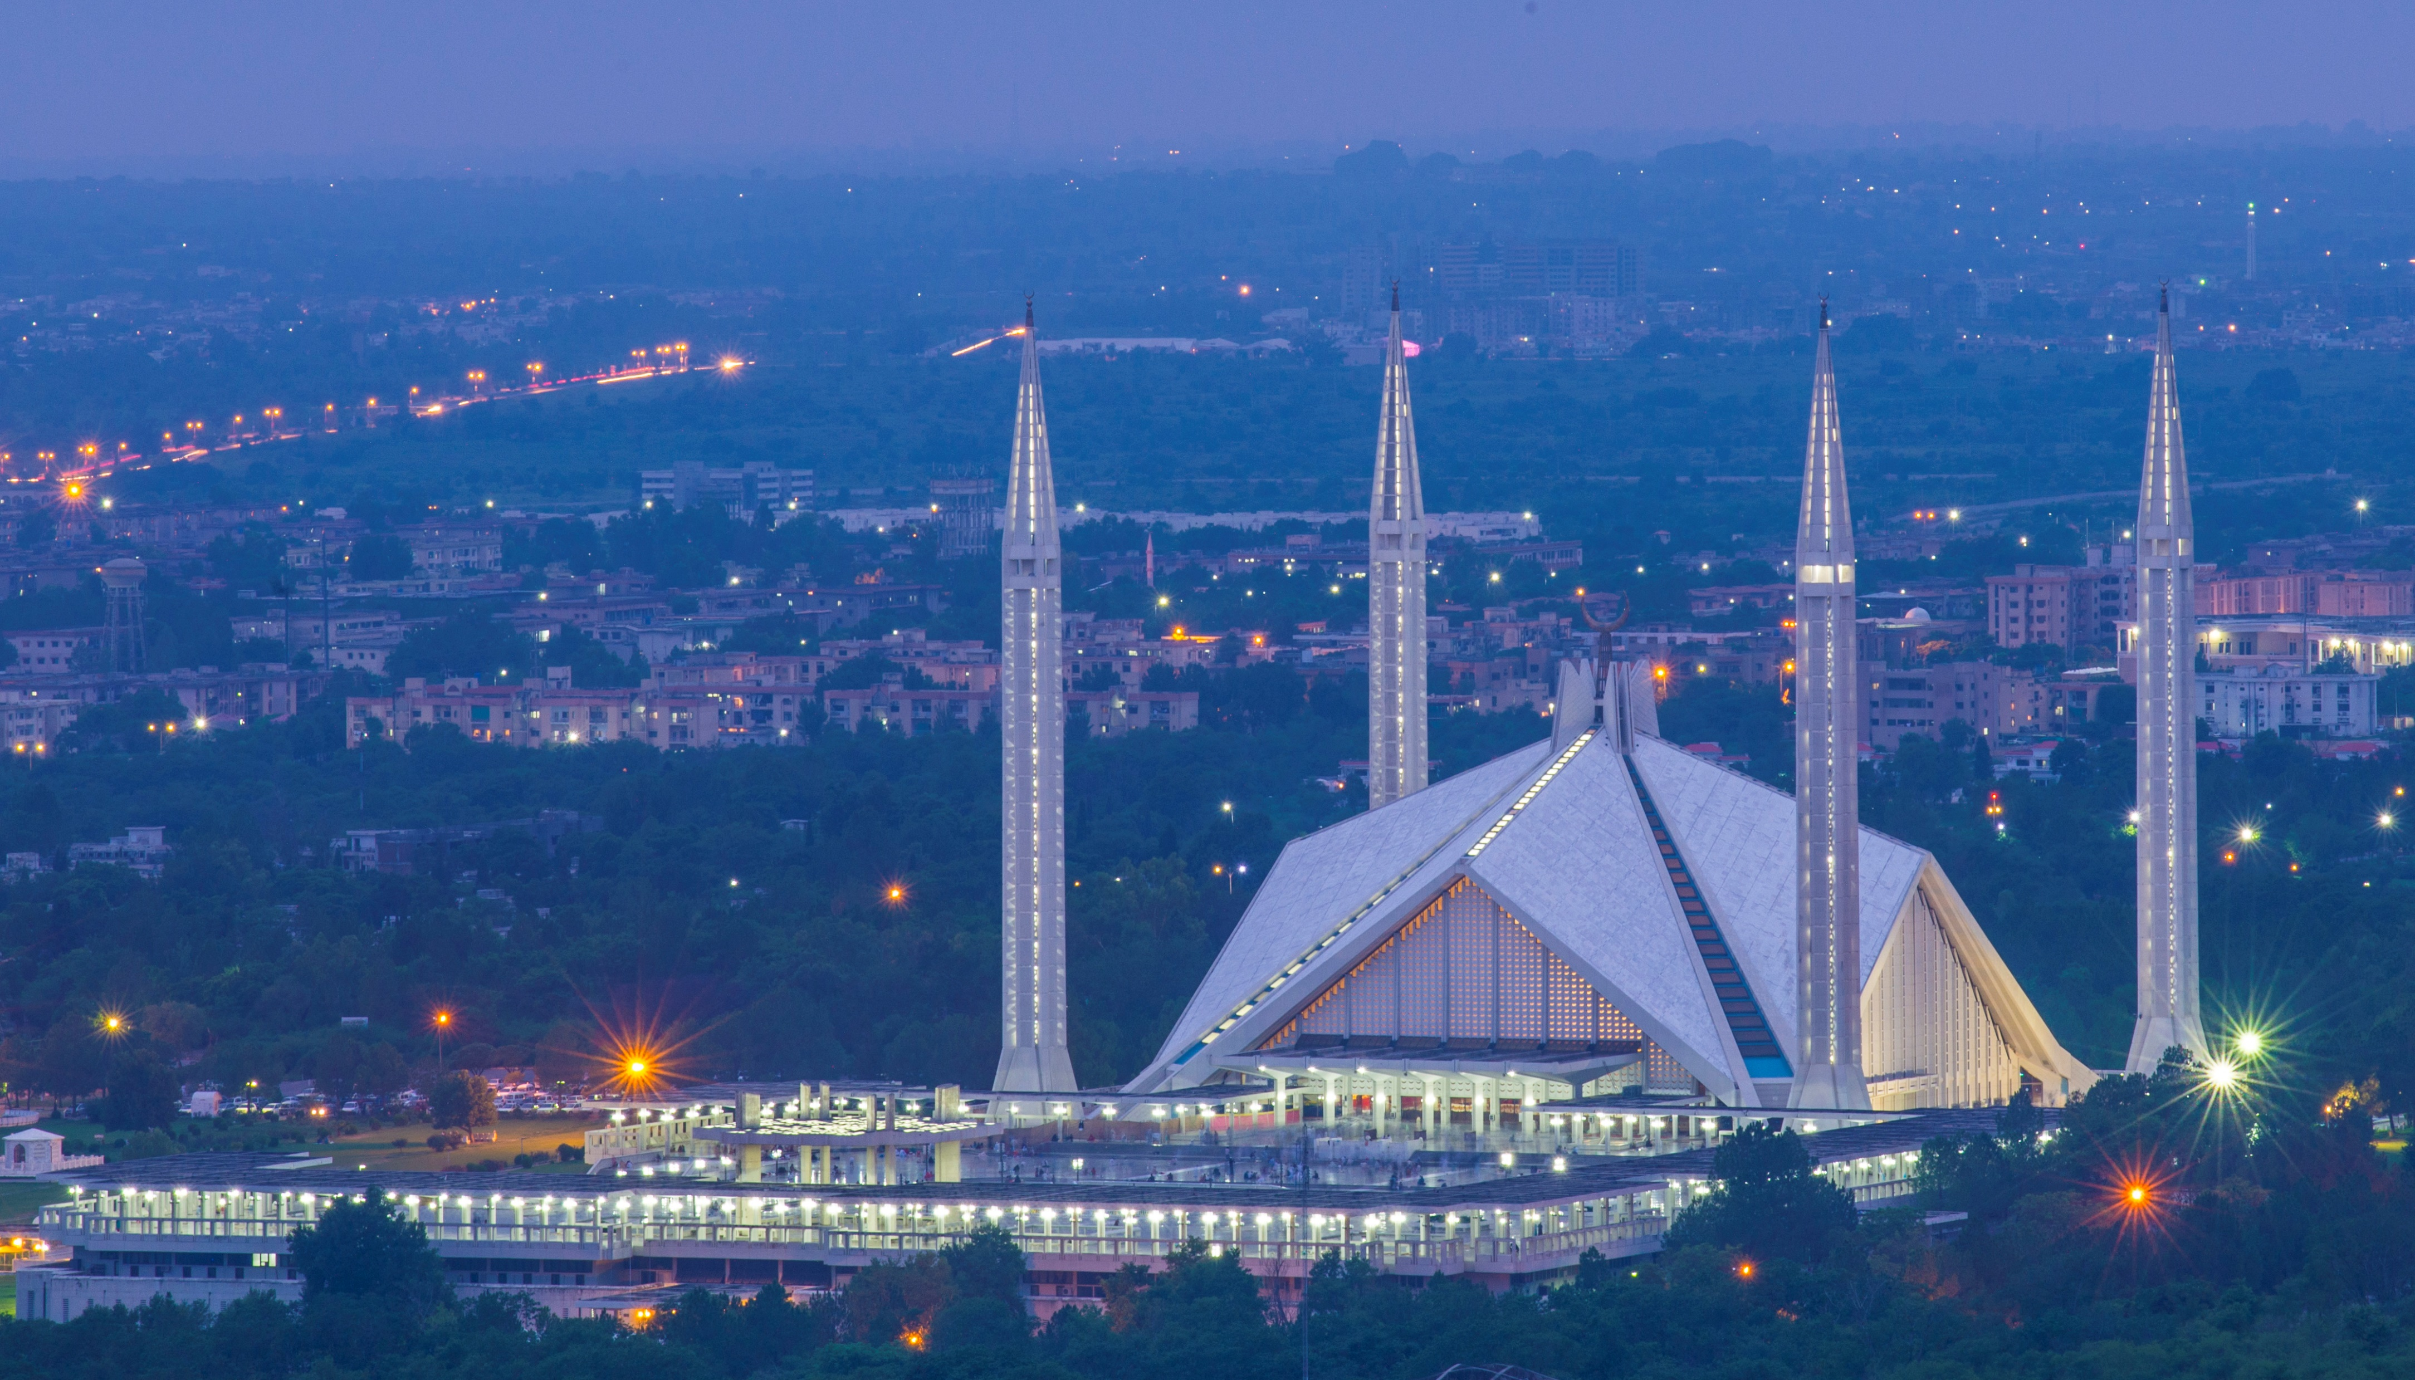
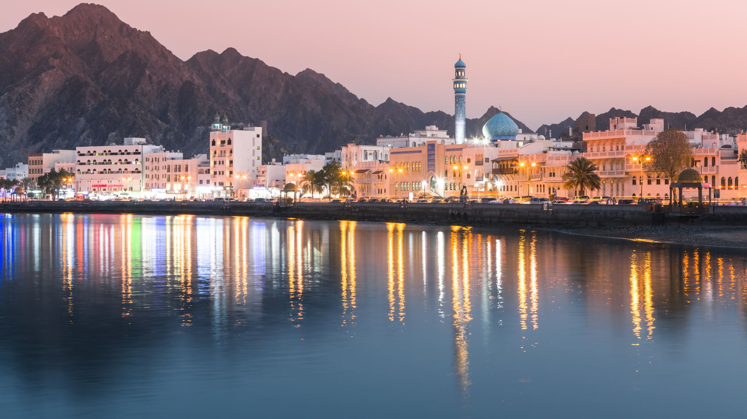
PART 5 Government and Institutional Efforts in Pakistan

Slide 29
Overview
Legal Repercussions for Misinformation in Pakistan:
Laws like the Prevention of Electronic Crimes Act criminalize knowingly spreading false information that harms reputation or privacy.
A recent bill makes deliberate disinformation punishable by fines and prison.
Fact: Digital citizens in Pakistan face legal consequences for spreading harmful fake news.

Slide 30
HEC initiatives
HEC Integration of Media Literacy:
The Higher Education Commission (HEC) of Pakistan has mandated that a Media and Information Literacy (MIL) course become a compulsory part of the undergraduate curriculum in Media and Communication Studies.
Collaboration with UNESCO:
HEC partnered with UNESCO to conduct curriculum design workshops, resulting in a comprehensive MIL syllabus for universities.
Broader Educational Impact:
HEC’s focus on MIL underscores its importance across disciplines, encouraging even non-media students to enhance their digital and media literacy.

Slide 31
Curriculum Development
UNESCO-HEC Workshop (Feb 2025):
Faculty from over 20 universities in Pakistan convened to develop a tailored Media and Information Literacy (MIL) framework.
Reference: UNESCO, HEC collaborate on Workshop to shape Media Literacy Curriculum in Pakistan – Daily Pakistan English News
Curriculum Template Outcome:
The resulting curriculum aligns with global best practices while being localized for Pakistan’s socio-cultural context.
Fact: This ensures relevance and effectiveness for Pakistani students.
Key Skill Areas Covered:
Critical thinking
Informed digital citizenship
Understanding misinformation tactics
Impact on Education:
When implemented, students will systematically learn essential media literacy skills—a significant step forward for the nation.
Fact: A structured MIL curriculum can empower future media consumers and creators in Pakistan.

Slide 32
Government Fact-Checking Efforts
Initiative Launch:
In 2018, the Ministry of Information launched a Twitter account called “FakeNews Buster” (later renamed “Fact Checker MoIB”) to counter fake news.
Functionality:
The account posts clarifications and labels certain news as fake, particularly targeting rumors about government policies.
Example: It tweets “Fake News Alert” along with correct information when false reports circulate about governmental decisions.
Fact: Such official fact-checking helps provide a verified source amid rampant misinformation.
Reference: Daily Pakistan English News
Limitations and Criticisms:
The initiative only catches a portion of false information.
Critics argue that as a government-run tool, it might prioritize protecting the government’s image over addressing all misinformation.
Fact: This limitation highlights the need for independent and multi-faceted fact-checking efforts.
Overall Impact:
While not a complete solution, the “Fact Checker MoIB” account represents one important piece in the broader puzzle of combating fake news in Pakistan.

Slide 33
PART 6 CONCLUSION AND CALL TO ACTION

Slide 34
CONCLUSION
Be Champions of Truth:
Embrace media literacy as a civic duty to detect and counter misinformation.
Fact: Informed citizens contribute to a healthier digital ecosystem.
Media Literacy is More Than Academics:
It’s essential for protecting our society and ensuring a smart, safe online environment.
Commit to Action:
Pledge to verify before sharing and to use your critical thinking skills every day.
Stay Curious, Critical, and Informed:
Continually question what you see online and seek reliable sources.
Call to Action:
Let’s use our media literacy skills to create smarter, safer digital communities—together, we can be champions of truth!

